Slide 1


Life Skills K-2nd
Ms Angi
Required
Change of clothes
Diapers and wipes if child requires them
Water bottle
Play dough
8 Pan washable water color set
Gallon and quart size ziplock bags
Box of Tissues
Glue sticks
5 or more packs of #2 wooden pencils

Slide 2
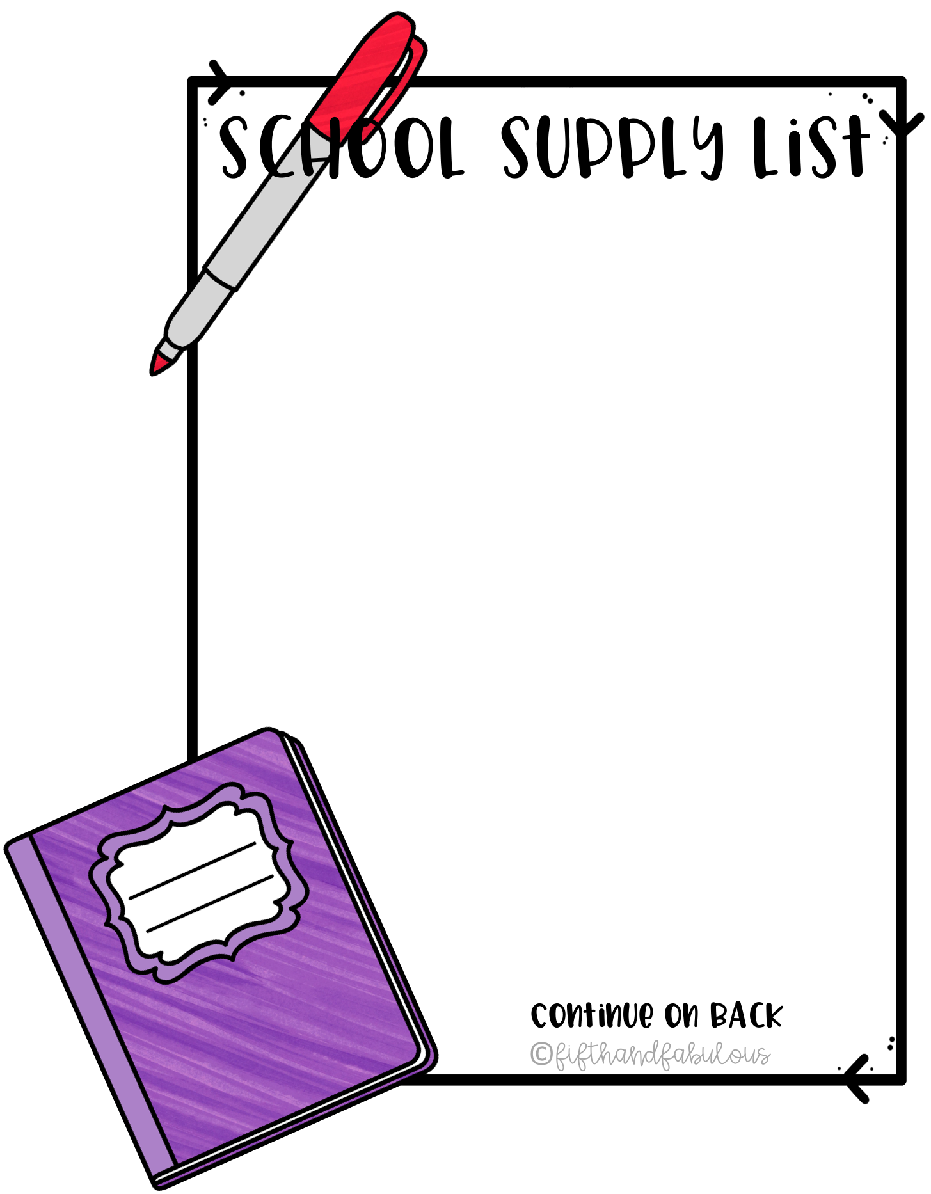
Life Skills K-2nd
Ms Angi
Optional:
Non Latex gloves
Snack to share
White Cardstock
Dish soap
Sponges
Cleaning Wipes

Slide 3


